Slide 1
Money Growing on Trees: A Classroom Game About Payments for Environmental Services in Community Forestry
Sahan Dissanayake, Portland State University
Sarah Jacobson, Williams College
May 2019

Slide 2
We’re Playing a Game!
You’ll roleplay as a rural household deciding whether to harvest from a forest or join a conservation contract
You’ll learn about climate change, payments for ecosystem service programs in general, REDD+ in particular, and more!

Slide 3
Background

Slide 4
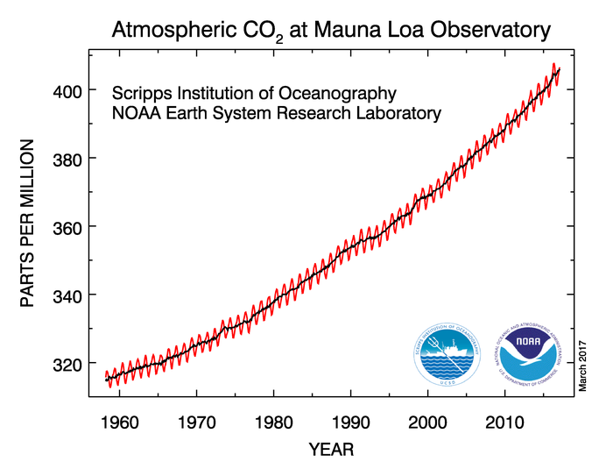

Slide 5
Climate Change and Forests
Net greenhouse gas emissions cause climate change
Abatement (mitigation) by …
Reducing sources (e.g. burning fossil fuels)
Increasing sinks (e.g. forests)
… relative to baseline (business as usual projection)

Slide 6
Avoiding Deforestation
Social benefit of abatement = avoided damages
Social cost of abatement?
→ Opportunity cost of land
Value foregone by not deforesting
Avoiding deforestation may be relatively low abatement cost way of reducing emissions

Slide 7
REDD+ and PES
Avoiding deforestation provides a public good
Payment for ecosystem services (PES) system
Compensate landowners for public goods they provide
→ internalize externality
Incentives let enviro goals be reached at lowest cost
REDD+: “Reducing Emissions from Deforestation and Forest Degradation” + sustainable management for enhanced carbon storage

Slide 8
Who Pays for REDD+ Contracts?
Regulated firm or country has to cut its emissions
Can offset direct emissions by paying for reductions elsewhere
Offset markets
Fit nicely into cap and trade systems
Buy an offset instead of buying a permit

Slide 9
Why is REDD+ Hard? Verifiability and Additionality
Verifiability
Is the promise to conserve being kept? (Fraud)
Additionality
Would this conservation action have happened without the conservation contract?
Bad because fraudulent or non-additional contracts don’t reduce net emissions
Waste money
Don’t reach intended emissions reduction target

Slide 10
The Game

Slide 11
REDD+ Roleplaying Game
You are a household in rural developing country
Decision:
Deforest = collect wood etc. from forest for subsistence
Value randomly assigned (playing card x $10)
vs.
Conserve = take payment, promise not to deforest

Slide 12
Treatments (Contract Periods)
Baseline
Baseline + Fraud
Harvest Uncertainty / Income Shock
Auction
Community Contract
Community Contract + Fraud

Slide 13
Read the instructions!

Slide 14
Contract Period 1: Baseline
Farming Income = $70
REDD+ payment = $50

Slide 15
CP1: What happened?
How did you decide?
Key concepts:
Opportunity cost / abatement cost
Additionality

Slide 16
Contract Period 2: Baseline + Fraud
Farming Income = $70
REDD+ payment = $50
Can harvest even if take REDD+ contract
25% chance of audit
If fraud found, lose REDD+ payment and harvest value, and pay $70 fine
Collect REDD+ & harvest decisions before audit

Slide 17
CP2: What Happened?
How did you decide?
Key concepts:
Rational theory of crime (Becker 1968)

Slide 18
Contract Period 3: Harvest Uncertainty
Farming Income = $70
REDD+ payment = $50
Harvest value if harvest
50% chance of $10 x your card
50% chance of $0
Find out which AFTER commit to REDD+

Slide 19
CP3: What Happened?
How did you decide?
Key concepts:
Choice under risk

Slide 20
Contract Period 4: Auction
Farming Income = $70
REDD+ payment: depends on bids!
Everyone write down bid to be in program
Lowest 50% of bids will be accepted
REDD+ payment = lowest bid that’s not accepted

Slide 21
CP4: What Happened?
How did you bid?
Key concepts:
Auction theory – incentive compatibility
PES auctions – cost-effectiveness – try to get ecosystem services at lowest social cost

Slide 22
Contract Period 5: Community Contract
Farming Income = $70
Grouped into communities
Within community, ALL or NONE in REDD+!
REDD+ payment = $50 per household (divide within community as you choose)
5 minutes to decide REDD+ or not

Slide 23
CP5: What Happened?
How did the community decide?
Key concepts:
Community governance (Ostrom, etc.)
Division of gains / power in community

Slide 24
Contract Period 6: Community Contract + Fraud
Farming Income = $70
REDD+ payment = $50 per hhold (divide as you choose)
Grouped into communities
ALL or NONE in REDD+!
Individuals can “cheat” by harvesting even in contract
Group can choose to police: $5 cost per household, makes cheating impossible
Unpoliced REDD+ contracts have 25% chance of audit
If ANY fraud found, ALL lose REDD+ payment & harvest value and pay $70 fine
5 minutes to decide REDD+ or not and whether to police; if yes REDD+ & no police, then step away for harvest decision

Slide 25
CP6: What Happened?
How did you decide?
Group and individual decisions
Key concepts:
Trust and cooperation
Self governance

Slide 26
Discussion
What is the biggest promise of REDD+?
What is REDD+’s biggest potential pitfall?
Do PES programs tend to be good or bad for equity / empowerment?

Slide 27
REDD+ Game Takeaways
Incentives for cost-effective abatement
Additionality
Verifiability
PES contracts as insurance
Community governance

